Slide 1
Spring Cloud Circuit Breaker

Slide 2
Fault Tolerance
For an application that depends on 30 services where each service has 99.99% uptime, here is what you can expect:
99.99^30 = 99.7% uptime
0.3% of 1 billion requests = 3,000,000 failures
2+ hours downtime/month if all dependencies have 99.99%
Reality is generally worse.
Source: https://github.com/Netflix/Hystrix/wiki
One failure must not cause a cascading failure across the entire system.

Slide 3
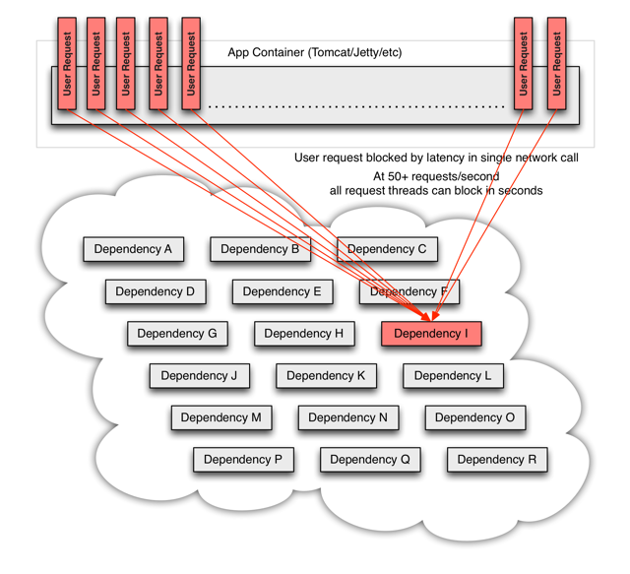
Distributed System Failures
One failure must not cause a cascading failure across the entire system.

Slide 4
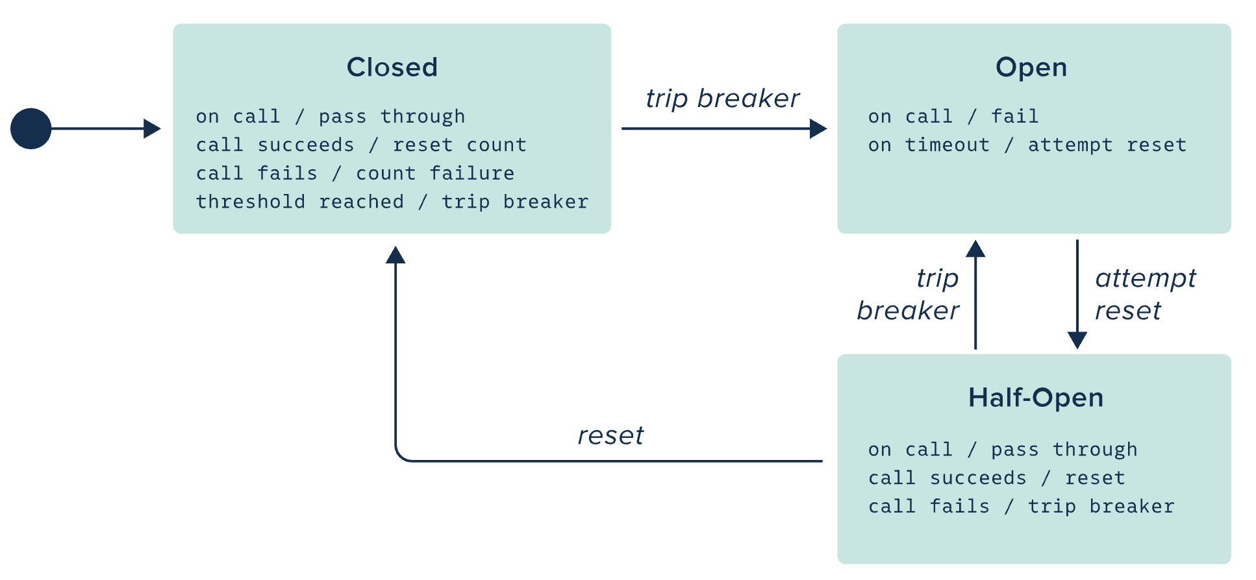
Circuit Breaker Pattern

Slide 5
Circuit Breaker Pattern Implementation
@SpringBootApplication
@EnableDiscoveryClient
@EnableCircuitBreaker
public class MyClientApp{
public static void main(String[] args) {
SpringApplication.run(MyClientApp.class, args);
}
}
pom.xml
<dependency>
<groupId>io.pivotal.spring.cloud</groupId>
<artifactId>spring-cloud-starter-hystrix</artifactId>
</dependency>

Slide 6
Spring Cloud Circuit Breakers
abstraction across different circuit breaker implementations
provides a consistent API for use in applications

Slide 7
Resilence4J

Slide 8
Metrics
Spring Cloud Circuit Breaker reposts Metrics via Micrometer
Informational and Status
Cumulative and Rolling Event Counts
Latency
Latency Percentiles: End-to-End Execution
Published from Boot as actuator metrics
PCF Metrics or Wavefront can capture metrics for Dashboards.

Slide 9

Transforming How The World Builds Software
© Copyright 2017 Pivotal Software, Inc. All rights Reserved.

